Slide 1
Personality Identification Using Facial Features
UNIVERSITY OF TECHNOLOGY (YATANARPON CYBER CITY)
Faculty of Information
&
Communication Technology
22 August 2019
* See slide notes for page directions
Notes:
When listing all project collaborators, either use commas or bullets

Slide 2
Member Lists
Towe Yadanar Hlaing (5IST-46)
Pann Ei Phyu (5IST-47)
Shoon Lae Yee Myo Aung (5IST-51)
Su Yati Myint (5IST-52)
Sandar Phyo Wai (5IST-57)
Hnin Wai Wai Aung (5IST-65)
Hsu Yee Hnin (5IST-70)
Notes:
Insert a map of your colony (draw it, ink it, or create it in PPT- be creative!)
Insert -> Pictures for photos
Draw for digital inking
Insert -> Shapes if you want to create it in PPT
All mountains, towns/villages, bodies of water/waterways, landmarks, etc. should be clearly labeled

Slide 3
Objective
Our MATLAB program intends to guess human’s personality based on their facial features, eyes shape and face shape.
In this MATLAB program, we capture a photo by webcam or upload existing images and we classify the face features. According to face shape and eye patterns, we guess the people’s personality.
To determine the personality of a person, facial features are chosen

Slide 4
Scope
First, we input the existing image or capture the image by webcam
To detect facial features, use Cascade object detector
Detect the face; Classify the facial features
Detect the edges by Canny Detector
Use the same structuring element for both operations by morphological close operation
Identify facial features by landmarks from an image of the subject’s face
Analyze the relative position, size and shape of the eyes by an algorithm
Notes:
Think about the questions listed above and answer them.
Can you think of anything else in regards to economy and trade that you would like to add?

Slide 5
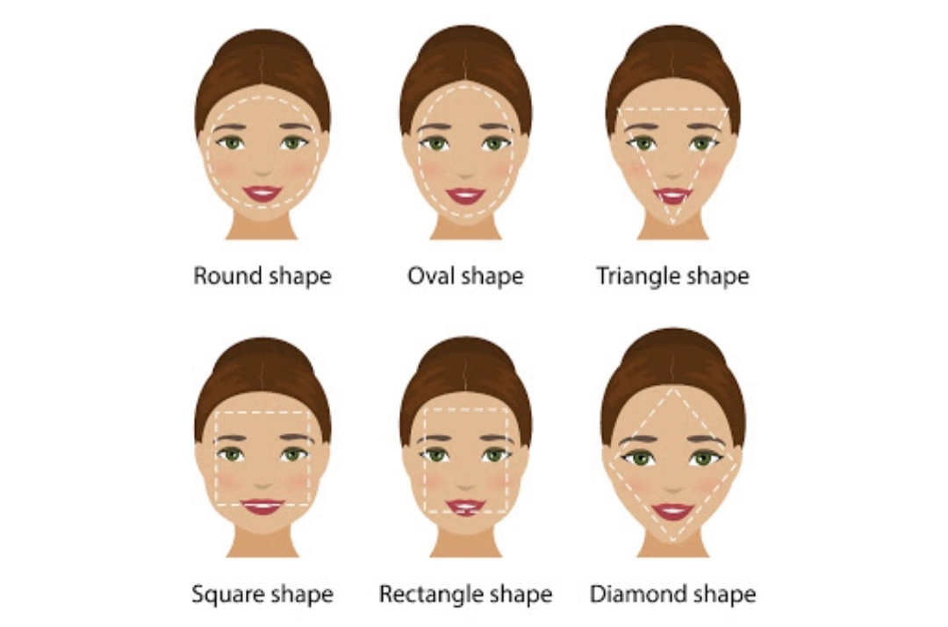
Face Shapes
The face is the portrait of the mind; the eyes; its informers(Latin Proverb)
Knowing your face shape is the first step to creating a beautiful look
Not sure of your face shape?
What you are looking for is one of the following:
Oval, Diamond, Rectangle, Triangle, Round, Square
Notes:
Use the SmartArt to determine the flow of government/leadership:
Who leads the colony (executive)? What is that person/are those people’s duties?
Who makes the rules (legislature)?
Who ensures the rules are followed (judicial)?
Are there any other branches of government? If so, who are they and what is their job?
To add more shapes, click on the left shape first, then on SmartArt Tools -> Design -> Add Shape After
Do the same for the shape to the right
Feel free to rename the branches!

Slide 6
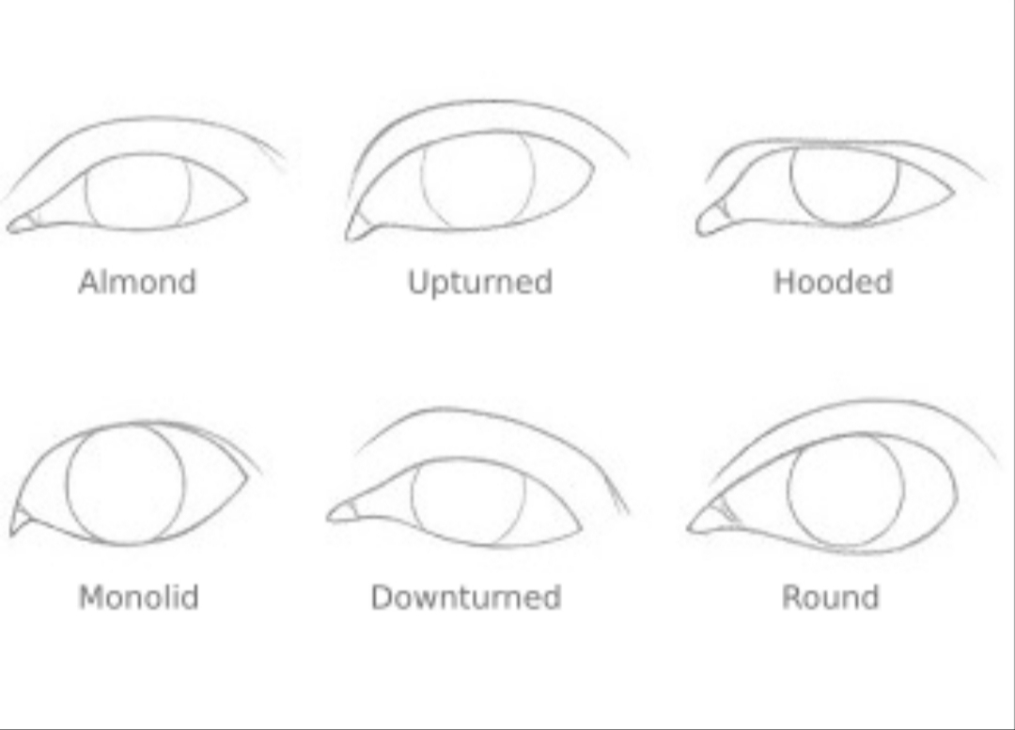
Eye Shapes
There are multiple different eye shapes such as Almond, Round, Downturned , Upturned , Monolid, Hooded eyes and etc.
Some people are unaware of the exact eye shapes they have, but it is fairly easy to determine your eyes shape on your own.
Vision and eye shapes are usually independent of each other
Notes:
Use the SmartArt to determine the flow of government/leadership:
Who leads the colony (executive)? What is that person/are those people’s duties?
Who makes the rules (legislature)?
Who ensures the rules are followed (judicial)?
Are there any other branches of government? If so, who are they and what is their job?
To add more shapes, click on the left shape first, then on SmartArt Tools -> Design -> Add Shape After
Do the same for the shape to the right
Feel free to rename the branches!

Slide 7
Detecting Face and Eyes Shapes
Face and eyes shape are implemented by using MATLAB
In this system, firstly connect webcam with MATLAB to capture and save photos and testing images
In real time, the image of human with a certain distance is acquired through webcam
Firstly, acquisition is performed and detected the facial parts of the image by using webcam.
The detected facial part is cropped and resized to the same size to all images for testing processes
The facial features are extracted from the detected human face using rule-based expert system.
Rule-based method is used to match the feature of test image for face classification.
Notes:
What are the rules and laws of your colony? Think about what helps the colonists stay safe and maintain a healthy, happy colony.
In each shape…
Name the rule/law
Describe why it’s important for the colony/colonists
Explain the consequences for not following this rule/law
To add more shapes, click on the last shape, then on SmartArt Tools -> Design -> Add Shape After

Slide 8
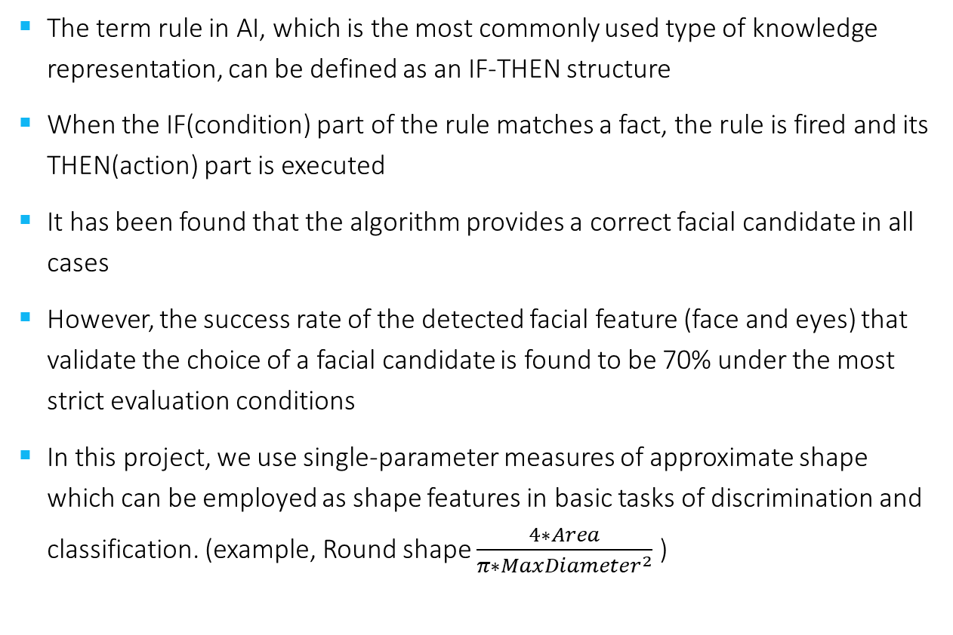
Applying Rule-based Expert System
The term rule in AI, which is the most commonly used type of knowledge representation, can be defined as an IF-THEN structure
When the IF(condition) part of the rule matches a fact, the rule is fired and its THEN(action) part is executed
It has been found that the algorithm provides a correct facial candidate in all cases
However, the success rate of the detected facial feature (face and eyes) that validate the choice of a facial candidate is found to be 70% under the most strict evaluation conditions
In this project, we use single-parameter measures of approximate shape which can be employed as shape features in basic tasks of discrimination and classification. (example, Round shape $\frac{4∗Area}{π∗{MaxDiameter}^{2}}$ )
Notes:
What is the name of your colony song?
Write lyrics to the song and, if you are feeling creative, use a computer program or instruments to create the music that goes along with it!
To insert an audio file, click on Recording -> Audio -> Audio on My PC and choose your file

Slide 9
Computing Personality using Facial Features
The features extracted in the input are measured
The character of the person is displayed
The facial measurements are computed and the final output is generated
Feature | Character
Round Face | Sensitive and Caring
Oval Face | Balanced and diplomats
Triangular Face | Creative, fiery temperament
Square Face | Intelligent, analytical skill, decisive mind
Rectangle Face | Dominant
Diamond Face | Kind and very giving
Notes:
Have fun with this slide! Use drawing paper or inking to create your colony’s flag, flower, bird, tree, and its most famous person!
If you use drawing paper, take a photo and insert the image
If you choose to use digital inking, click on the Draw tab and ink away!

Slide 10
Conclusion
The character can be easily analyzed by measuring the facial features. Testing of the result generated is evaluated by conducting a personal interview with the people whose image was given as an input to the code. It is said that the thinking traits forms the physiological features: what we achieved is that given the physical features we have evolved a method to identify the characteristics or personality of the person.

Slide 11
Thank You For Your Attention

